Slide 1

Peanut Exporters

Slide 2
Company Details
Company Name : South India Seed Exporters
Establishment : 2005
Business Scope : Groundnut/Peanut Exporters
Company Location : 8/244,Kothapet, Sri Kalahasti, Chittoor Dist, Andhra Pradesh, Pincode - 517644, India
Contacts: Cell: +91-7842177725, +91-9885700402
Landline: +91-8578-222385
Email: southindiaseedexporters@gmail.com, waseem@southindiaseedexporters.com
Website: www.southindiaseedexporters.com
Executives: Managing Director - B.S.Akram
General Manager – Noorjahan, Sales & Marketing – Waseem

Slide 3
About Us
We at South India Seed Exporters are the leading manufacturers and exporters of quality Indian Peanut, spices, and take pride in continuing to be part of India's traditional export of peanut, capable of meeting the standards of the international Peanut industry.
Our company is registered with "APEDA". Our team comprises of highly dedicated & trained professionals to perform various functions such as purchase, processing, quality control and packaging etc. These professionals are best in the industry and strive to achieve perfection in all aspects of their fields of work.
South India Seed Exporters has been started with a mission to serve the world best quality peanuts. by serving and helping each entity in the process. We have tie ups with Farmers through “SERP” who we help in growing natural and pure peanuts.

Slide 4
Our Objective
Our objective is to become one of the leading market share holder in one of the most competitive market in the world.
Our Goal
Customer satisfaction is the ultimate goal of our company. Also providing the best quality for our customers.

Slide 5
Mission Statement
We are committed to provide the best quality product to our customers and agreed upon terms.
Vision Statement
By purchasing from farmers we have the ability to get the best quality and we are improving life standards of our farmers by giving them suitable price for their crops. We would like to make the world to be healthy place by providing quality products in eco-friendly manner.

Slide 6
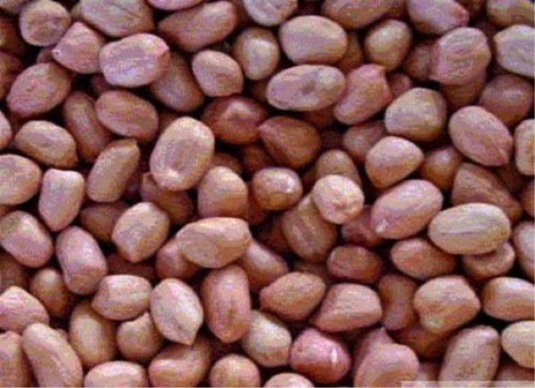
Product – Peanut/Groundnut
Bold Count: 35/40, 38/42, 40/45, 45/55, 55/60, 70/80 Java Count: 50/60,60 /65, 60/70, 70/80, 80/90, 90/100 ,140/160 (Kalyani) & Non-Counting Dark Red Skin Peanut Kernels – 60-70, 70-80 and 80-90
Specifications:
Origin: India Moisture: 8% max, Admixture: 1% max
Imperfect Grains : 1% max, Aflatoxin(B1+B2+G1+G2): 5 PPB max (TLC method)10 and 20 PPB (HPLC/ELISA method with B1B2 condition) Packing Type: In Strong Jute Bags(gunny Bag),
Packing: 50 Kg /25Kg o As Per Buyer Requirement

Slide 7
Why Us
Prompt Delivery: Our Emphasis is to provide timely and hassle free delivery service as promised.
Premium Quality: We have high standards and our goal is to sell the highest quality peanuts we possibly can to our customers.
Most Competitive Prices: We keep up our prices upto date and precise so our customers are assured of best prices.

Slide 8
Contact Us
We look forward to hearing from you by phone or e-mail. We will reply to your e-mail within two working days. If you need immediate assistance give us a phone call or message us via whatsapp or regular message.
Address:
8/244, Kothapet, Sri Kalahasti, Chittoor Dist,Andhra Pradesh
India, Pincode: 517644
Mobile No:+91-7842177725, +91-9885700402
Landline: +91-8578-222385
Email: southindiaseedexporters@gmail.com, waseem@southindiaseedexporters.com
Website: www.southindiaseedexporters.com

